Slide 1
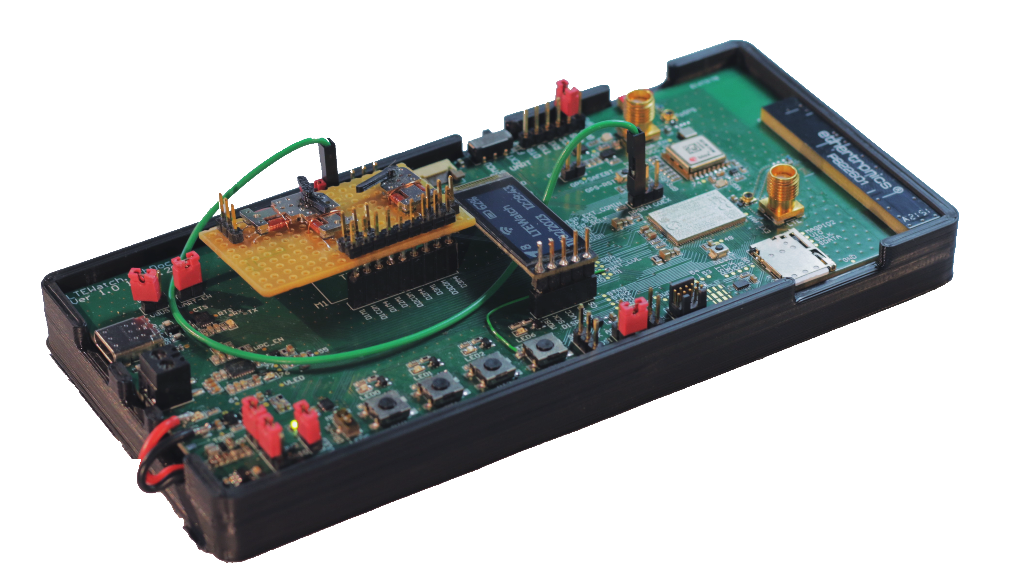
TM Project Defense
Analog LTE-M / NB-IoT Watch
Tristan Traiber – 22.02.2022 – MSE – EIE - TIN

Slide 2
TM Project Defense - Analog LTE-M / NB-IoT Watch
Table of contents
Introduction
Project Description
Scope & Limitation
Literature Review & Research
Wearable & Low-Power App
System MCU (nRF9160 SiP)
System Power Supply
Cellular IoT & GNSS
Results & Solutions
Specification
Functional Decomposition
Component Selection
Hardware Part
Electrical Schematic
LTEWatch Prototype Board
Antenna Part
Cellular (LTE-M/NB-IoT)
GNSS
Software Part
LTEWatch Application Decomposition
LTEWatch Application Diagram
Software Architecture
External Library
Hardware Description
Test & Result
LTEWatch Device
GNSS & LTE-M/NB-IoT
Discussion
Personal Evaluation
Remaining Work
Conclusion

Slide 3
Introduction
Project Description
About Nordic Semiconductor
Fabless Semiconductor Company from Norway
Specialized in wireless communication technologies and IoT
Pioneer role in development of Bluetooth Low Energy (BLE)
Currently developing for ANT+, Thread, Zigbee, LTE-M/NB-IoT, Wi-Fi and GSMA
Goals & Objectives
Develop an analog wristwatch with cellular LTE-M/NB-IoT communication and GNSS position tracking using Nordic’s nRF91 family of devices.

Slide 4
Introduction
Scope & Limitation – Task List
Specification
Elaborate the specification of the device (number of clock hands, battery lifetime, user interface, size, recharging mechanism, case)
Antenna
Study and implement antenna solutions for both GNSS and LTE-M/NB-IoT
Hardware
Component selection
Design of the schematic and PCB of a prototype
Assembly and electrical testing of the prototype
Software
Develop a simple watch application that must implement motorized clock’s hands, buttons, LCD, LTE-M/NB-IoT communication using the MQTT protocol, GNSS position and time tracking, battery charging and level monitoring, accelerometer.
Prototype validation
Test and validation of the entire development
Documentation
Establish a technical report enabling further developments

Slide 5
Introduction
Scope & Limitation – Project Constraint
Limited Time (20 weeks)
Too limited to develop a complete product solution
Focus on the development of a proof of concept (POC)
Develop the system architecture and validate the hardware solution as well as the software implementation capability
Prefer good, reliable and simple solutions to perfect, complex and risky solutions
Limited Resourses
Prefer smart and economical solutions
Require to sacrifice some optimization against the availability and accessibility of the solution
Keep solution as versatile as possible for further improvement or modification
Avoid customized or overly specific solutions as much as possible to minimize dependency to suppliers and current market situation

Slide 6
Literature Review & Research
Wearable & Low-Power application’s constraints considerations
Mechanical
Portability: Increase component density and decrease weight by using more expensive fully integrated components
Ergonomics: Increase size and accessibility of user interface (touchscreen)
Price and availability
Ease of production: Number of components and system complexity
Performance
Battery life: Reduce wasted power by using more efficient components
Thermal dissipation: Ultra-compact
Charging time: Maximum charging current capability
Quiescent current (IQ)
Current drawn by an active IC
When in non-switching (stable) and a no-load (disconnected) configuration

Slide 7
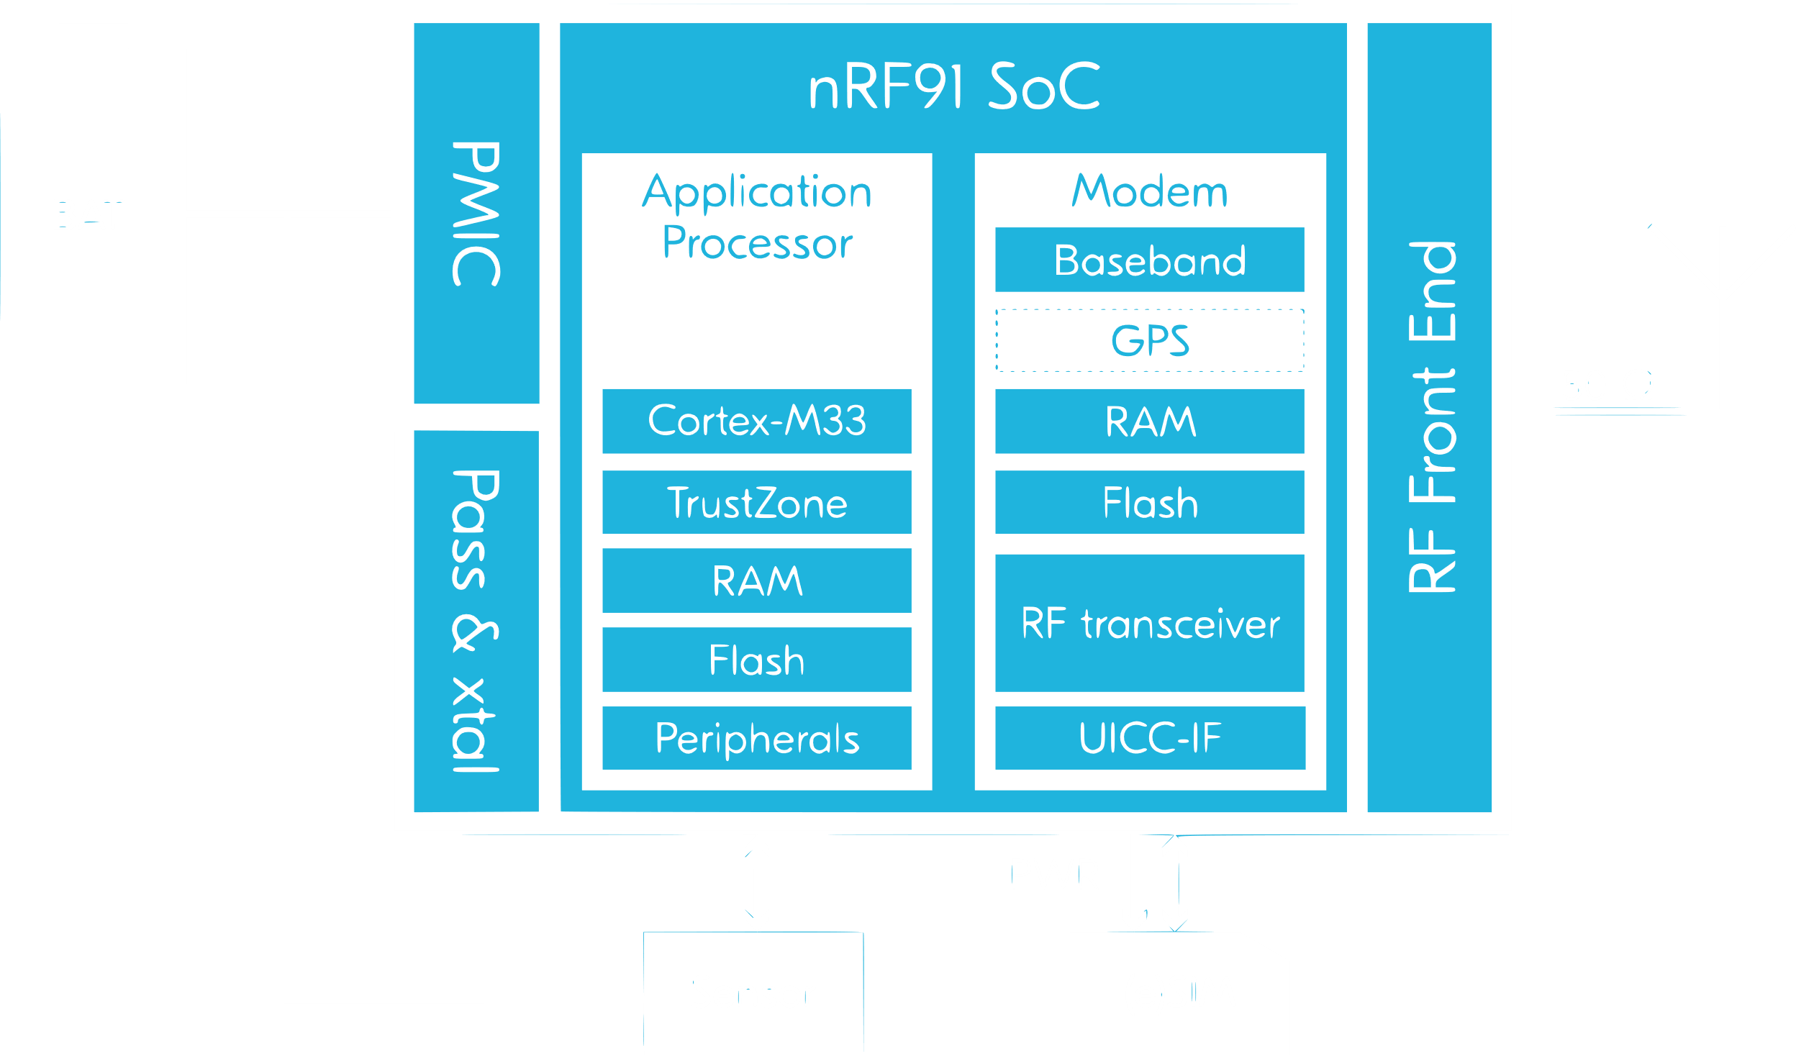
Literature Review & Research
System MCU (nRF9160 SiP)
Multimode LTE-M/NB-IoT modem
700-2200 MHz LTE band
+23 dBm output power
eDRX and PSM power saving features
Single pin 50 Ω antenna interface
UICC interface (SIM/eSIM)
Application processor and memory
64 MHz Arm® Cortex®-M33 CPU
Arm TrustZone® for trusted execution
Arm CryptoCell 310 (App. Lay. Security)
1 MB Flash & 256 KB RAM
Application Circuit - nRF9160 SiP Product Brief

Slide 8
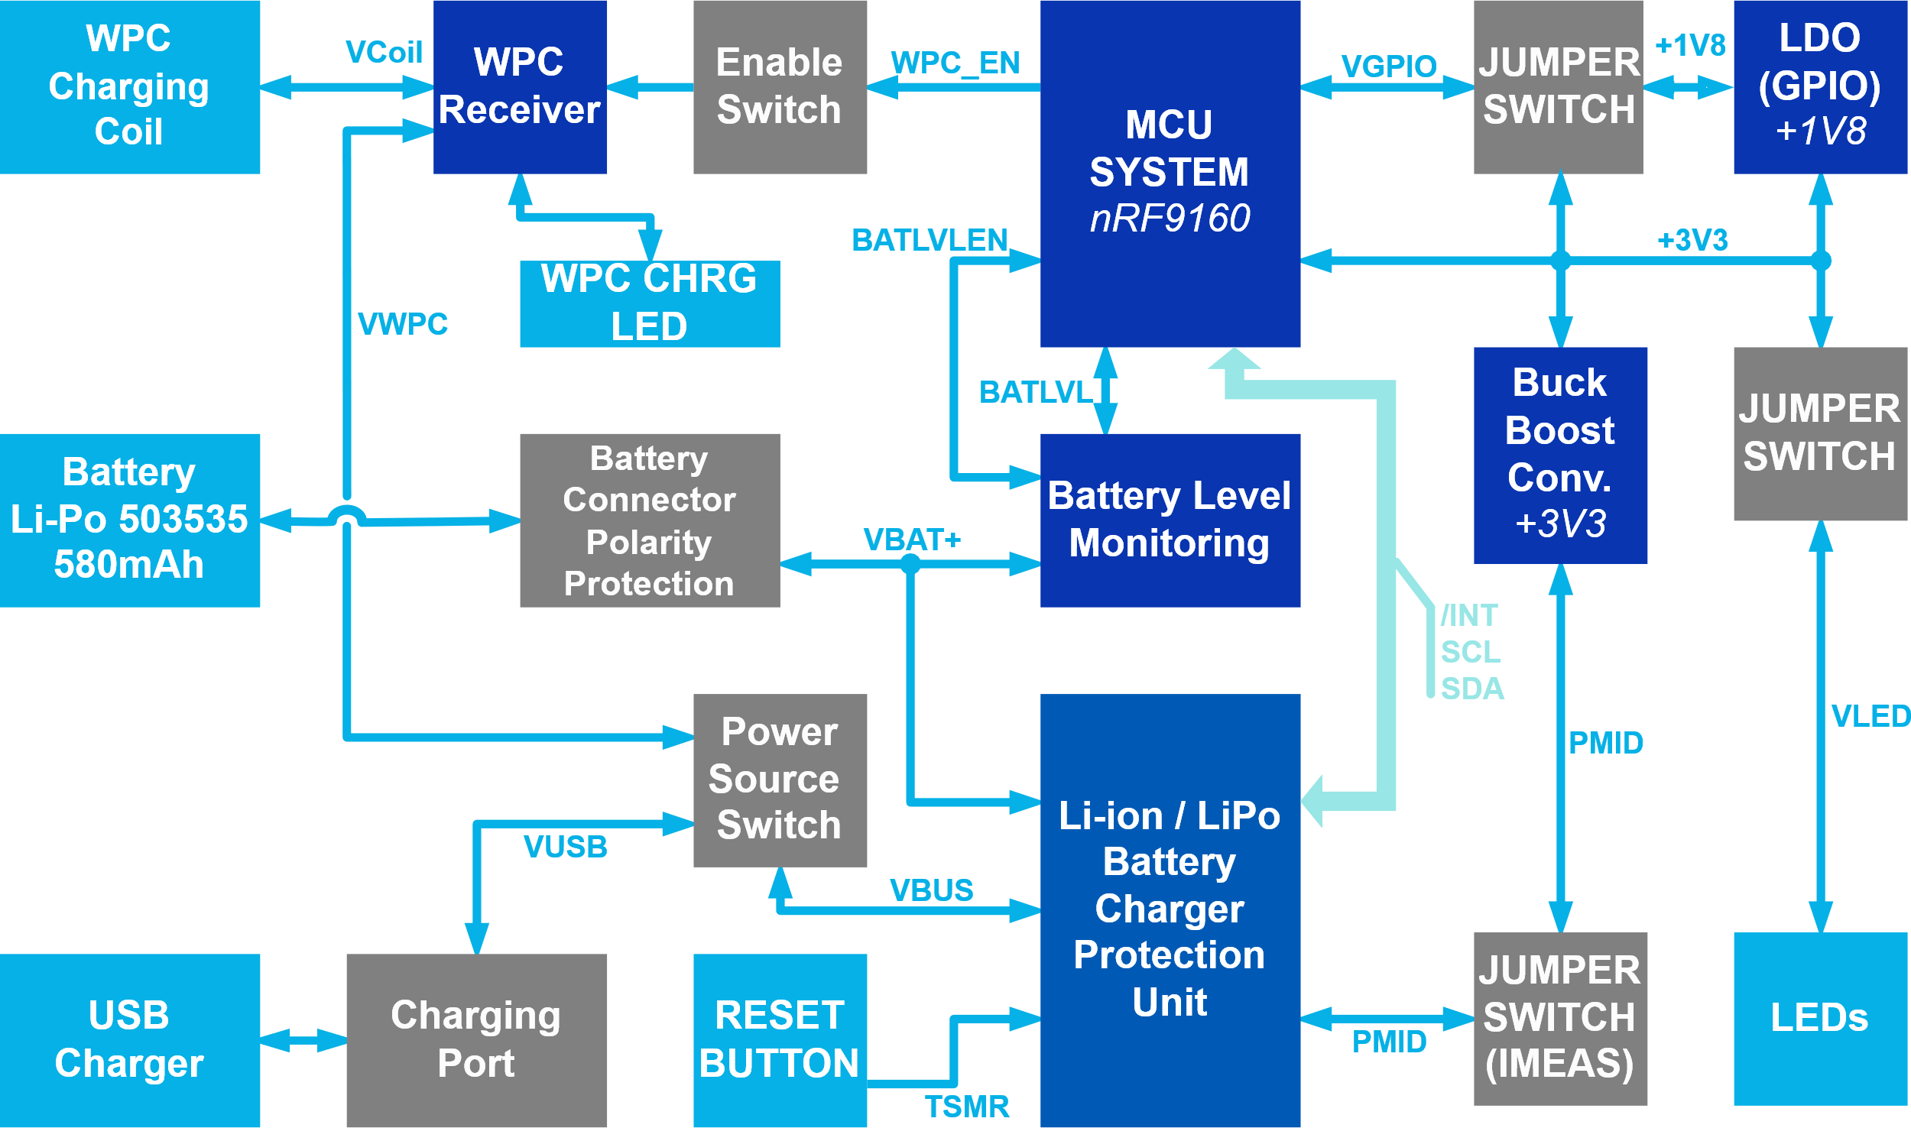
Literature Review & Research
System Power Supply
Power Supply Source
Input Supply Protection
Battery Manager
Battery Charger
Battery Protection
Power Source Switch
System Supply Manager
Battery Level Monitoring
Power Supply Indicator
System Supply Measure/Switch
4
1
2
5
3
7
6

Slide 9
Literature Review & Research
Cellular IoT
LTE (Long-Term Evolution)
Wireless broadband communication and data terminals standard (Mobile devices)
Based on GSM/EDGE and UMTS/HSPA
Bandwidth: 20 MHz
LTE-M (Machine Type Communication)
LTE low-power equivalent machine to machine communication standard
Bandwidth: 1.4 MHz
Lower throughput: ~100 kbit/s
Longer range than LTE
NB-IoT (Narrowband IoT)
Drastically narrower bandwidth (200kHz)
Longer range than LTE-M
Lower throughput: ~30 kbit/s
MQTT (Telemetry Transport)
Machine to machine network protocol
Publish–subscribe messaging pattern intended for message queue and message queuing service
Run over ordered, lossless and bidirectional connections transport protocol (TCP/IP)

Slide 10
Literature Review & Research
Global Navigation Satellite System (GNSS)
Definition
Satellite constellation providing PNT* services on a global or regional basis.
Main PNT services
BeiDou (BDS): People’s Republic of China (PRC) - 30 satellites
Galileo: European Union - 30 satellites
GLONASS: Russian Fed. - 24 satellites
1. Positioning (P)
2. Navigation (N)
3. Timing (T)
IRNSS/NavIC: India - 7 satellites. IRNSS (Autonomous system to cover India)
QZSS: Japan (Operated by QZS System Service Inc. (QSS)) - 5 satellites

Slide 11
Results & Solutions
System Specification
Power supply
Must be powered by battery
Must be rechargeable by USB-C and WPC
Must have battery life of at least 24h
Data display
Time must be displayed with three mini stepper motors
Must implement LCD screen
Computing unit (MCU)
Must implement the nRF9160 from Nordic
User interface
Must implement buttons as user interface
An accelerometer can be added
Radio frequency (RF)
Must implement a GNSS receiver
Must implement LTE-M/NB-IoT transceiver
Must implement on-board antenna for both GNSS and LTE-M/NB-IoT
Must have SMA connectors for external antenna for GNSS and LTE-M/NB-IoT

Slide 12
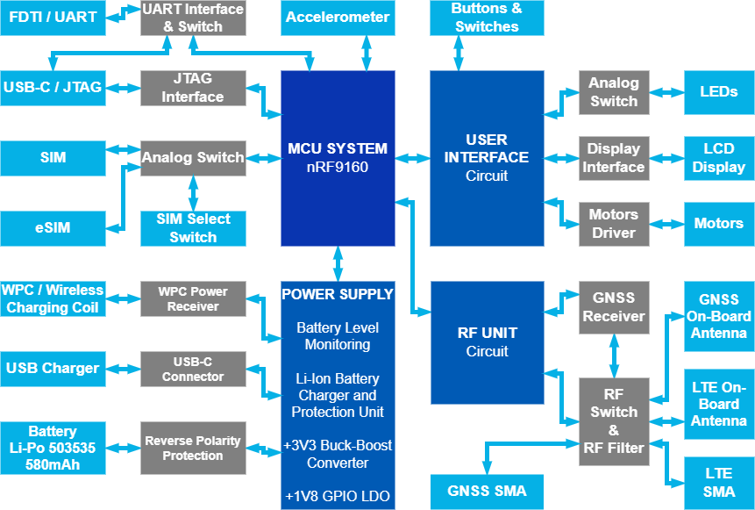
Results & Solutions
Functional Decomposition
System Functional Block Decomposition
Power Supply Block
User Interface Block
Data Display Block
RF Communication Block
MCU & Programming Block
Data Display
User Interface
MCU & Prog.
RF Com.
Power Supply
RF

Slide 13
Results & Solutions
Component Selection - Overview
Power Supply
Li-ion/LiPo Battery Charger : Ti BQ25180
Buck Boost Converter (+3V3) : Ti TPS63036
LDO Regulator (+1V8) : Ti TPS7A03
Wireless (WPC/QI) Receiver : Ti BQ51013B
Computing Unit (MCU)
System MCU : Nordic Semi. nRF9160
User Interface
USB To UART Interface : FTDI Chip FT234XD
Data Display
LCD Display : SHARP LS011B7DH03
Motors : TITAN T901A/T902
User Interface
Accelerometer : mCube MC3635
Radio Frequency (RF)
GNSS Receiver : u-blox MAX-M10S
GNSS Antenna : Ignion NN03-320
LTE-M/NB-IoT Antenna : P822602 (Universal Broadband FR4 Embedded LTE/LPWA Ant.)

Slide 14

Results & Solutions
Power Supply – Battery Charger
Settings
Fully programmable by integrated I2C serial bus
Consumption
System Protection
Thermal reg. & shutdown
Watchdog & safety timer
Input OVP : 25V
Battery Protection
FET Power Path
Battery thermal protection
Battery short protection
Charge and discharge current limit (1.1 / 2.5 A)
Battery UVP & OVP
Size & Package
8-pin DSBGA (1.6×1.1)
Shutdown | Ship | Battery | Sleep
15 nA | 3.2 µA | 3 µA | 30 µA
Simplified Schematic - BQ25180 datasheet

Slide 15

Results & Solutions
Power Supply – Buck Boost Converter (+3V3)
Performances
Input voltage from 1.8V to 5.5V
Adjustable output voltage from 1.2V to 5.5V
High efficiency over entire load range
Consumption
Low operating quiescent current : 25 µA
Power saving mode available
Safety & Protection features
Thermal protection
Over-voltage protection
Load disconnect during shutdown
Size & Package
8-pin WCSP package (1.814 mm × 1.076 mm)
Efficiency
> 90% : 1.5 mA < ILoad < 300 mA
> 80% : 1.5 µA < ILoad < 800 mA
Application Circuit - TPS63036 datasheet

Slide 16

Results & Solutions
Power Supply – Wireless Power Receiver (WPC)
Specification & performances
Overall peak AC-DC efficiency: 93%
WPC v1.2 compliant communication control
Output voltage conditioning & input voltage up to 20V
Control and safety features
Thermal shutdown protection
Rectifier over-voltage clamp with low-power dissipation (15V)
Control pin for temp. monitoring, charge complete & host check
Size & package
VQFN 20-Pin : 4.5 mm × 3.5 mm
DSBGA 28-Pin : 3.0 mm × 1.9 mm
« Dual Power Path » Application Circuit - BQ51013B datasheet

Slide 17

Results & Solutions
User Interface - Accelerometer
Range, Sampling and Power
±2/4/8/12/16g ranges up to 10’000g
8/10/12-bit FIFO or 14-bit single samples
14...1300 sample/s (Intern. OSC / CLK Pin / SOFT)
Sniff and Wake modes (0.4 µA Sniff current, 6 Hz)
Ultra-Low Power 32 samples FIFO
System Integration
I2C interface : ≤ 1 MHz
SPI Interface : ≤ 4 MHz
Single-chip 10p (Silicon MEMS) 1.6×1.6×0.94 mm
Low noise to 2.3 mg (RMS)
25 Hz | 50 Hz | 100 Hz | 1.3 kHz
0.9 µA | 1.6 µA | 2.8 µA | 36 µA
Typical 4-wire SPI Application Circuit – MC3635 Datasheet

Slide 18
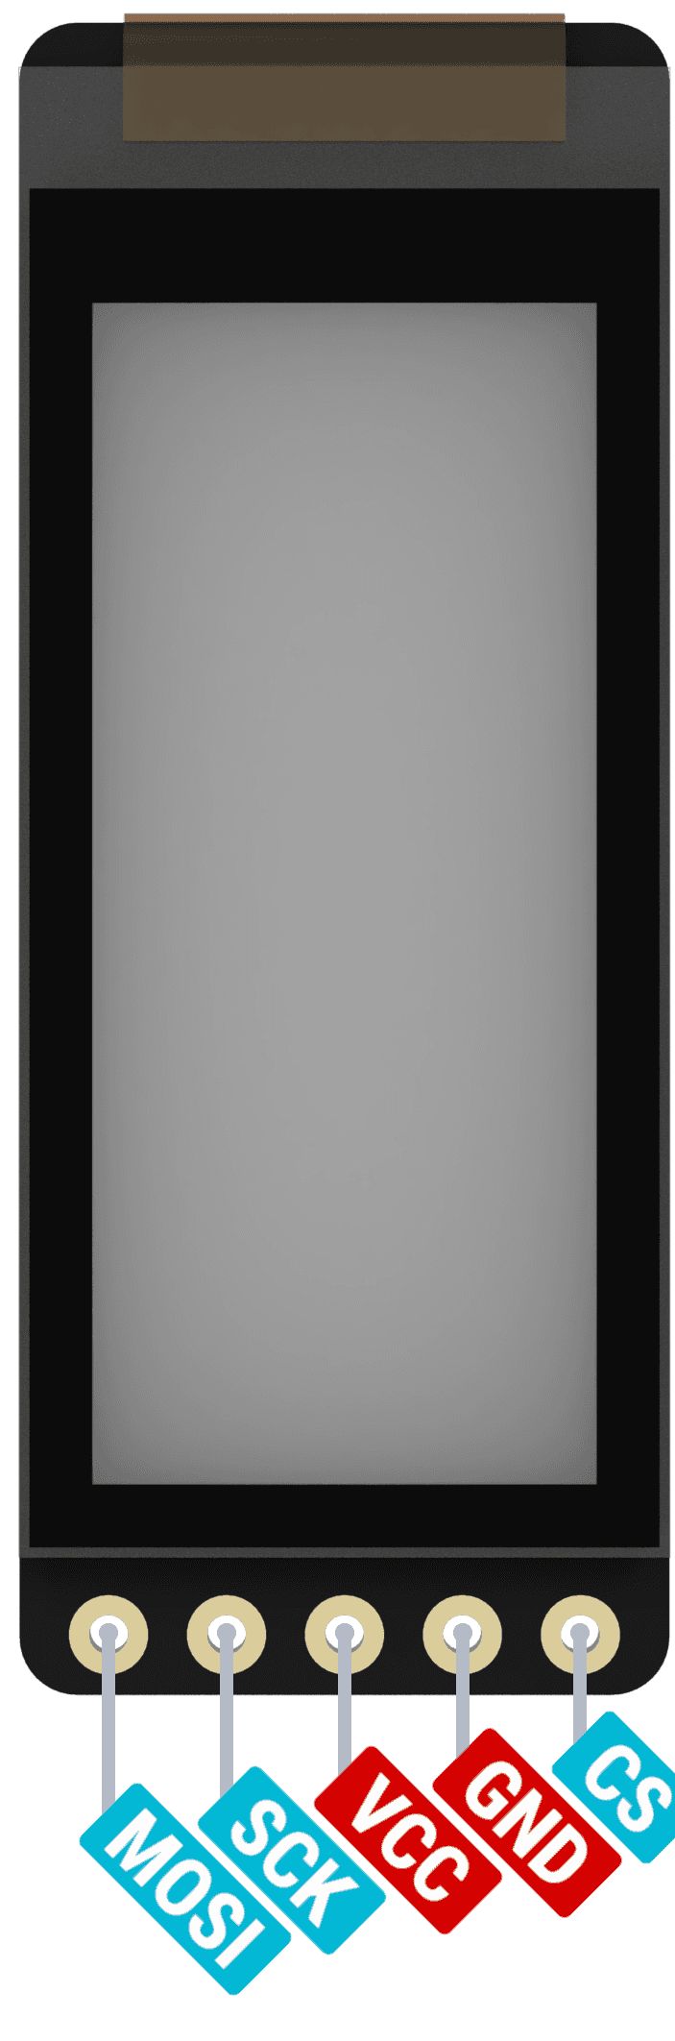
Results & Solutions
Data Display – LCD Screen
Performances and Image Quality
Reflective monochrome TFT-LCD
1.08” diagonal & 160×68 resolution
Polarized anti-glare front surface
Refresh rate range up to 70 Hz
Power Consumption
Controls and Interfaces
10-Pin flat cable FPC type connector
3-wire SPI serial data signal (≤ 1MHz)
Integrated data storage of 1 bit/px
Arbitrary line data write mode
Mechanical Properties
Compact, thin & lightweight monolithic construction panel
Outline dimension 32×14×0.745 mm
MODE | TYP | MAX
Hold (Black) | 15 µW | 50 µW
Update (1Hz) | 25 µW | 100 µW
Breakout Board (nice!view)
Pinout and Schematic

Slide 19
Results & Solutions
Data Display – Motors
Performances and Image Quality
Reflective
Power Consumption
MODE | TYP | MAX
Hold (Black) | 15 µW | 50 µW
Update (1Hz) | 25 µW | 100 µW
Breakout Board (nice!view)
Pinout and Schematic

Slide 20
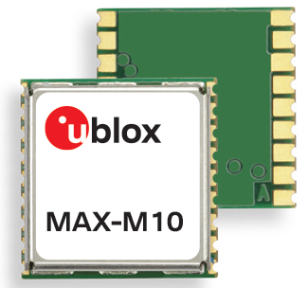
Results & Solutions
RF – GNSS Receiver - Overview
Description
Ultra-low-power M10 platform with extremely good performances for all L1 GNSS systems
Performance
Consumption in cont. tracking mode: < 25 mW
↗ Position availability : concurrent reception of (GPS, GLONASS, Galileo and BeiDou)
↗ Reliability in challenging conditions (urban)
Super-S Technology (u-blox)
Excellent sensitivity with small antennas
+25% of dyn. position accuracy (non-line-of-sight)
Integrated Features
LNA & SAW filter : ↗ sensitivity (passive antenna)
Provide advanced spoofing and jamming detection
Size & Package
Pin-to-pin compatibility with previous generations (MAX-6, MAX-7 & M8)
Size : 10.1 mm × 9.7 mm
Parameter | GPS+GAL | GPS + GAL + GLO | GPS + GAL + BDS B1I | GPS + GAL + BDS B1C | GPS + GAL + GLO + BDS B1C
Update rate (max) | 10 Hz | 10 Hz | 10 Hz | 10 Hz | 10 Hz
Position accuracy | 1.5 m | 1.5 m | 1.5 m | 1.5 m | 1.5 m
MAX-M10S Data Sheet

Slide 21
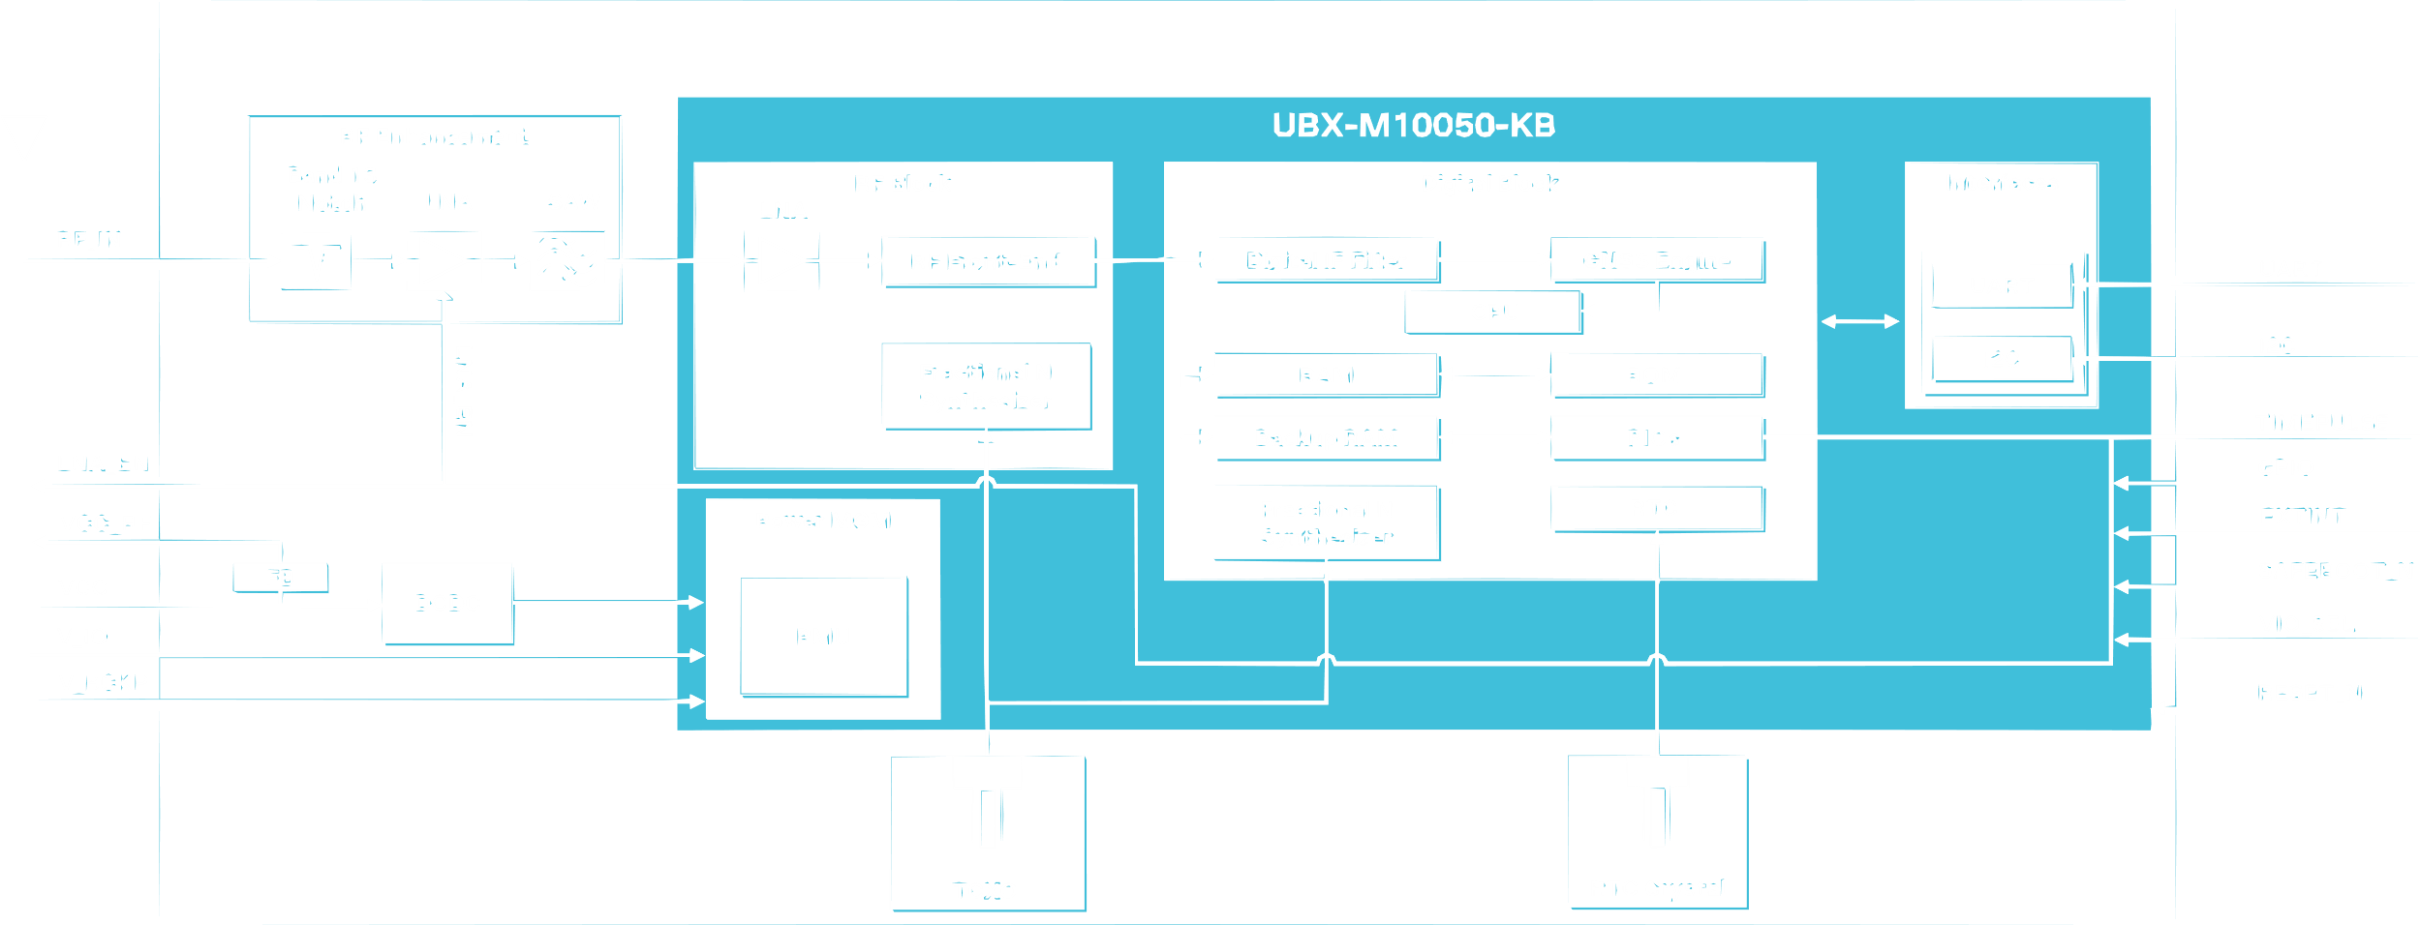
Results & Solutions
RF – GNSS Receiver – Functional Diagram
MAX-M10S Module
MAX-M10S Data Sheet

Slide 22
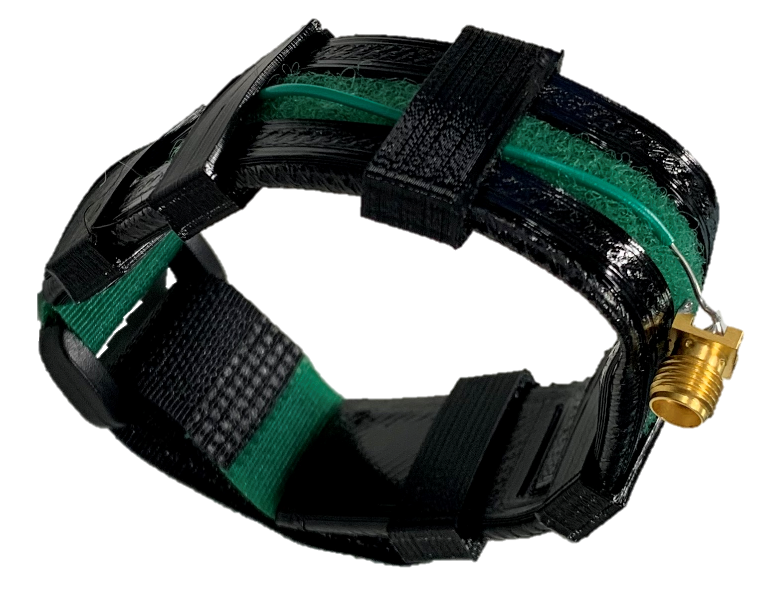
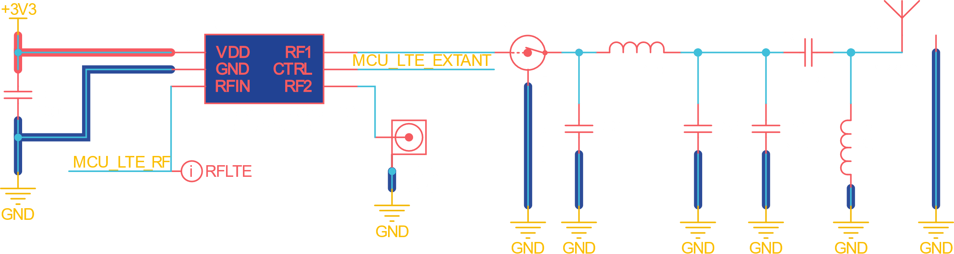
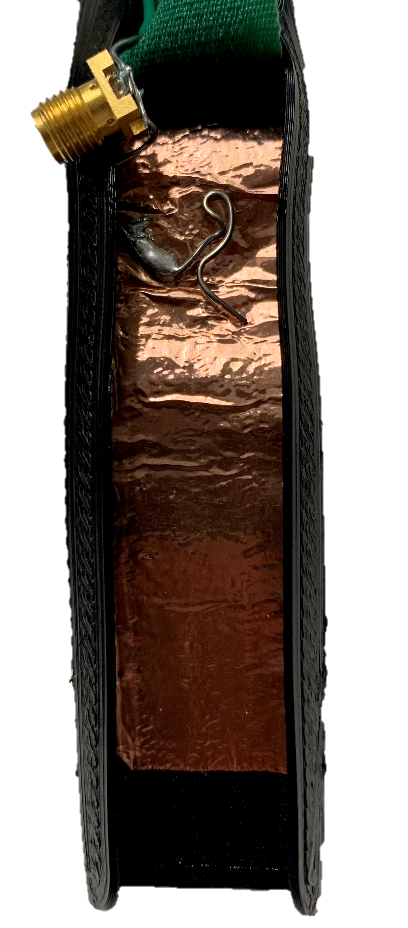
Antenna Part
Cellular (LTE-M/NB-IoT)
On Board LTE-M/NB-IoT Antenna
P822602 (Universal Broadband FR4 Embedded LTE/LPWA Ant.)
Based on the nRF9160DK board
Watch Strap Antenna
Functional 800 MHz Dipole Antenna
Easy and cost-effective RF solution
Connection between antenna and device is the weak point

Slide 23
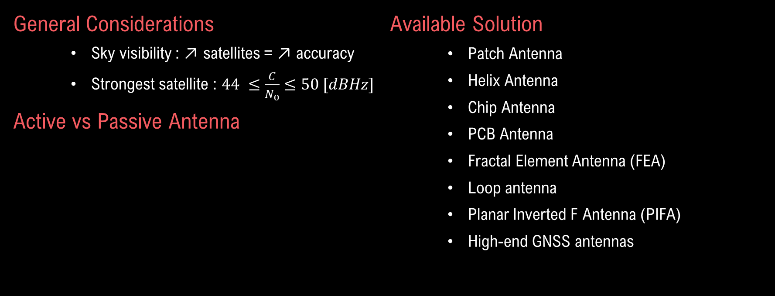
Antenna Part
GNSS – Antenna Basics
General Considerations
Sky visibility : ↗ satellites = ↗ accuracy
Strongest satellite : $44 ≤\frac{C}{N_{0}}≤50 [dBHz]$
Active vs Passive Antenna
Available Solution
Patch Antenna
Helix Antenna
Chip Antenna
PCB Antenna
Fractal Element Antenna (FEA)
Loop antenna
Planar Inverted F Antenna (PIFA)
High-end GNSS antennas
Monopole Antenna
Active antenna | Passive antenna
↗ power (10-60 mW) | Does not add to power budget
More tolerant to minor impedance miss-match or cable length | RF line max length & design is critical (max length = 10 cm)
Keep receiver noise figure low | Sensitivity to jamming signals coupled to the RF line
Less affected by jamming signals (if equipped with filter) | RF design experience is required to properly design a passive antenna
Dipole Antenna

Slide 24
Antenna Part
GNSS – Patch vs Chip Antenna
Patch Antenna
Most common antenna for GNSS
Ideal for flat surface mounting
Low cost
Very high gain capable
Size range (40 × 40 mm to 10 × 10 mm)
Require a large ground (min. 50 × 50 mm)
Smaller antenna = lower overall gain
Amplifying the signal after the antenna will not improve the SNR
Chip Antenna
More and more common for compact app.
Extremely low cost & ultra-low-power
Ultra-small size available (3.2×1.6×1.1mm)
Relatively high gain
Omni-directional radiation patterns
Require more careful RF design : sensitive to footprint, ground plane size & keep-out area
Respecting all recommendations does not guaranty performance due to potential detuning effects created by nearby objects

Slide 25
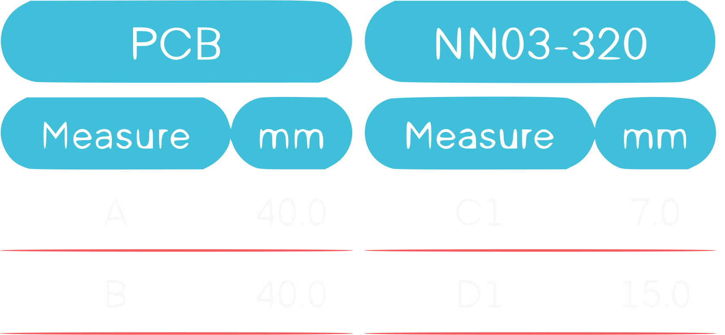
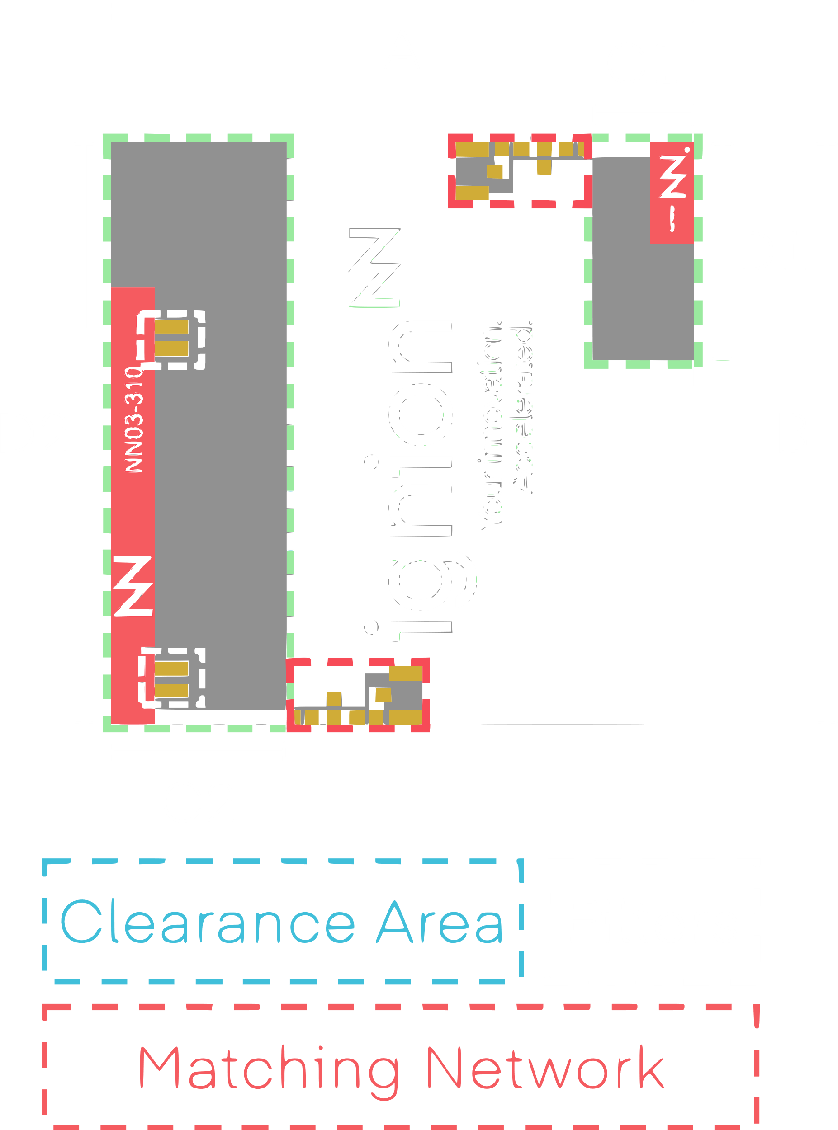
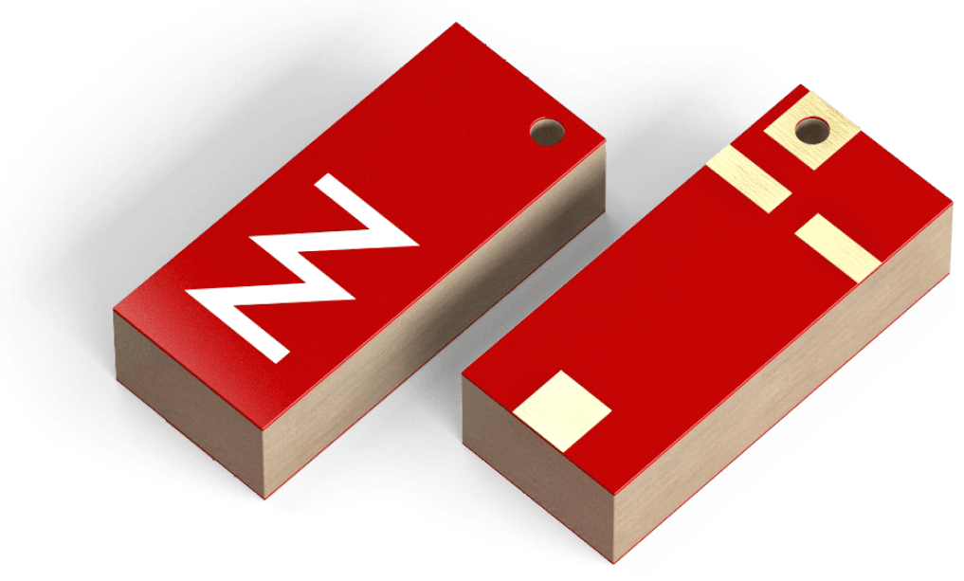
Antenna Part
GNSS – Ignion DUO mXTEND (NN03-320)
Features
High efficiency
Low power consumption
Operating range : 1561 -10600 MHz
Best for : 1561 - 5875 MHz
Multipurpose : Multiband IoT chip antenna component with multiport (2 ports)
No clearance beyond the antenna footprint
Compact size : 7.0 × 3.0 × 2.0 mm
Versatile : Device corner or center edge
Reliability : Off-the-Shelf standard product
DUO mXTEND - Datasheet

Slide 26
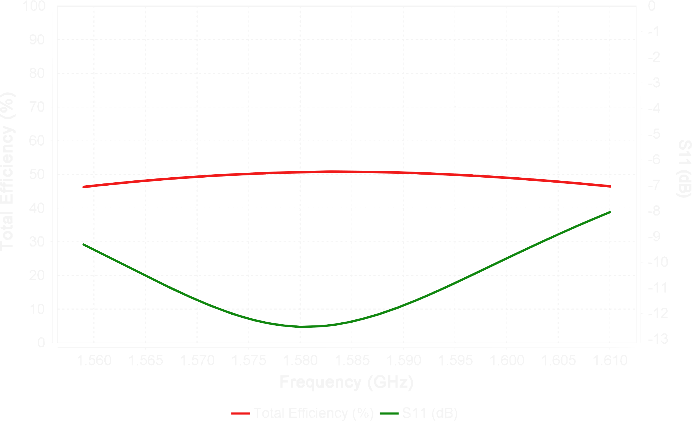
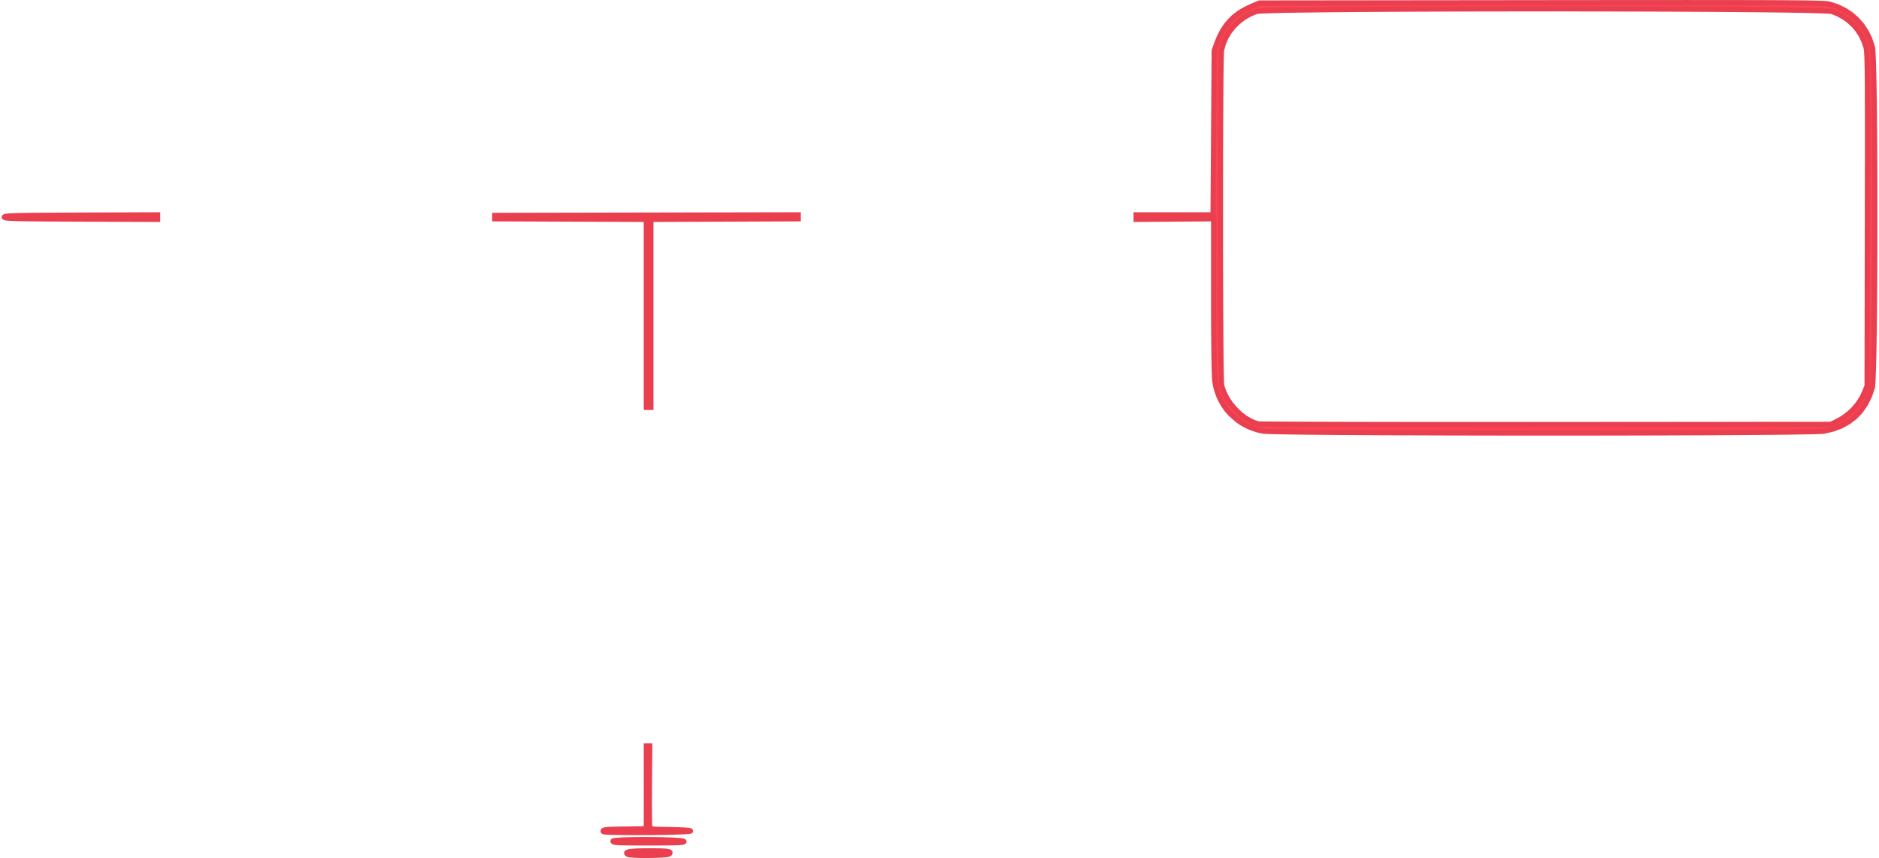
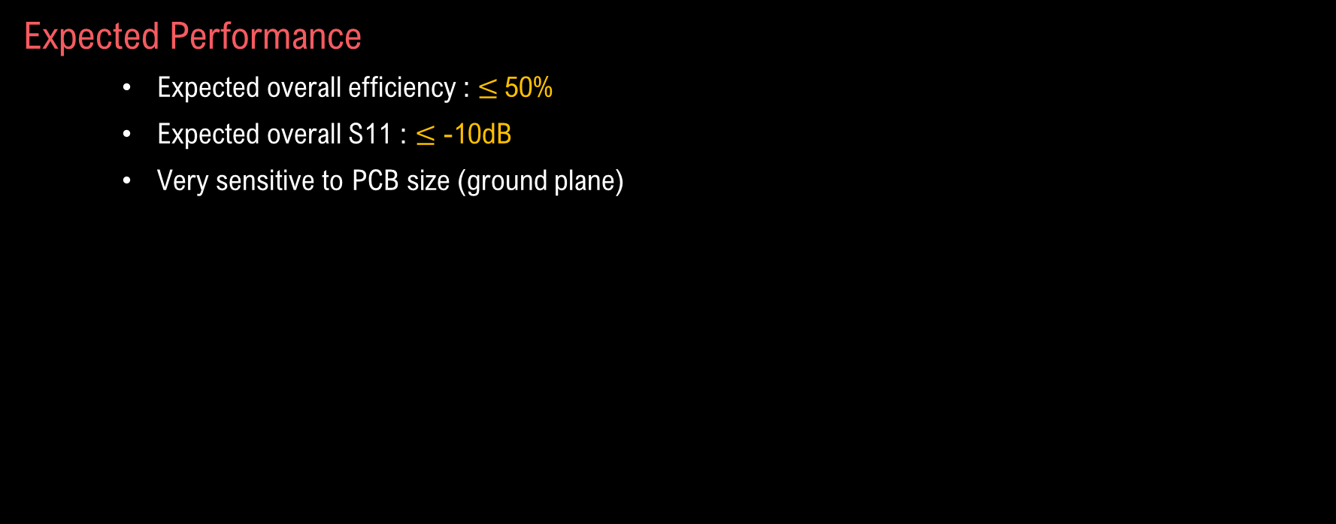
Antenna Part
GNSS – Ignion DUO mXTEND (NN03-320)
Expected Performance
Expected overall efficiency : $≤$50%
Expected overall S11 : $≤$ -10dB
Very sensitive to PCB size (ground plane)
ID | Value | Part Number | Manuf.
Z1 | 11nH | LQW18AN11NG80 | Murata
Z2 | 13nH | LQW18AN13NG80 | Murata
Z3 | 9.7nH | LQW15AN9N7G80 | Murata
Frequency (MHz) | 1559 | 1610 | Avg. 1559 - 1610
Total efficiency (%) | 46.3 | 46.5 | 49.2

Slide 27
Hardware Part
Electrical Schematic
…
….

Slide 28
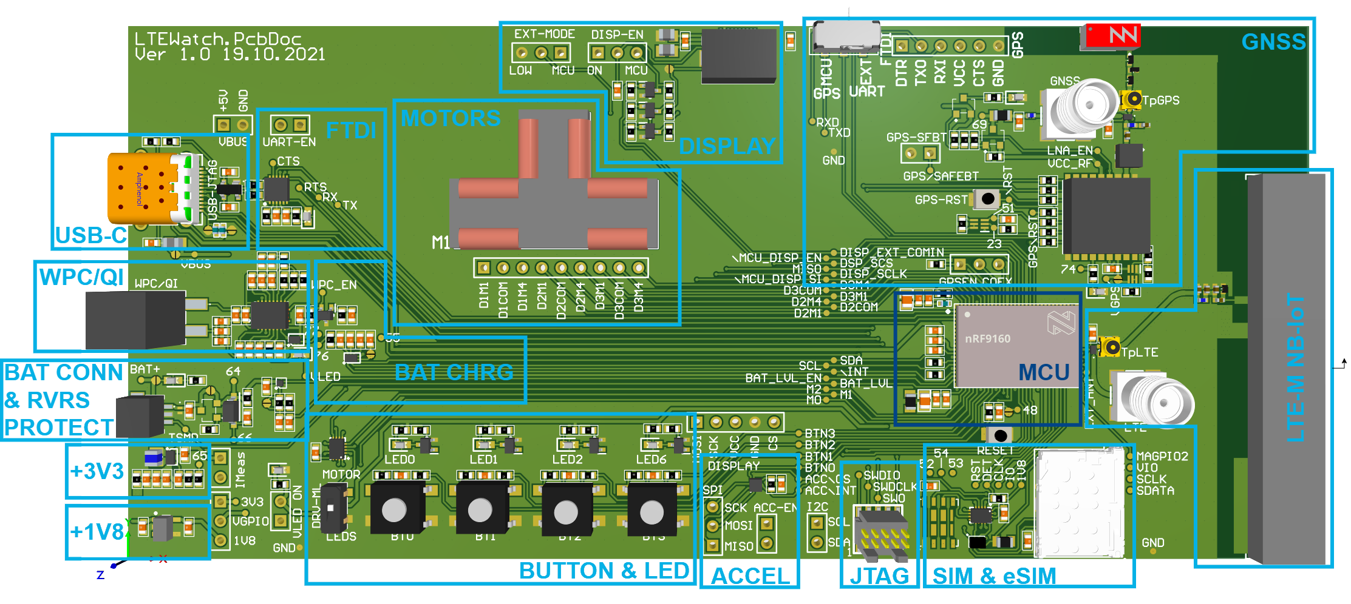
Hardware Part
LTEWatch Prototype Board (PCB)

Slide 29
Software Part
LTEWatch Application Decomposition
R
F
&
N
e
t
w
o
r
k
D
e
b
u
g
g
i
n
S
g
y
s
t
e
m
M
C
U
n
R
F
9
1
6
L
0
T
E
P
0
.
0
7
U
S
B
_
R
X
L
}
T
E
_
E
X
T
_
A
N
T
M
A
G
P
I
O
0
F
T
D
U
I
A
R
P
T
0
.
0
6
U
S
B
_
T
{
X
G
P
S
-
R
X
D
P
0
.
2
U
4
A
R
T
G
P
S
-
T
X
D
P
0
.
2
3
P
0
.
1
7
=
>
B
T
N
2
P
0
.
1
8
=
>
B
T
N
E
1
X
T
I
N
T
M
A
G
P
I
O
G
1
N
S
S
R
e
c
e
i
v
e
r
P
0
.
1
9
=
>
B
T
N
0
U
s
e
r
I
n
t
e
r
f
a
c
/
e
R
S
T
P
0
.
2
5
P
0
.
1
3
=
>
M
2
=
>
L
E
D
2
P
0
.
1
7
.
.
1
P
9
0
.
1
4
=
>
M
1
=
>
L
E
D
1
B
u
t
t
o
n
G
s
P
S
-
E
N
C
O
E
X
0
B
T
N
0
.
.
P
2
0
.
1
5
=
>
M
0
=
>
L
E
D
0
&
L
E
D
I
s
2
C
P
0
.
0
8
-
S
D
A
P
0
.
1
3
.
.
1
5
L
E
D
0
.
.
2
M
o
t
o
r
P
s
0
.
0
9
-
S
C
L
P
0
.
0
.
.
5
M
0
.
.
S
8
D
A
S
D
S
A
C
L
P
0
.
0
0
=
>
M
8
P
0
.
2
7
D
I
S
P
_
/
E
P
N
o
w
e
r
S
u
p
p
l
y
S
C
L
P
0
.
0
1
=
>
M
7
D
i
s
p
l
a
P
y
0
.
0
2
=
>
M
6
P
0
.
2
8
D
I
S
P
_
S
C
M
S
O
S
P
I
0
.
0
3
=
>
M
S
5
D
B
A
a
t
t
e
r
y
I
2
C
S
C
K
-
P
0
.
3
0
S
C
K
S
P
P
I
0
.
0
4
=
>
M
S
4
C
L
P
0
.
0
5
=
>
M
C
3
h
a
r
g
e
r
B
A
T
_
/
I
N
T
_
C
H
R
G
P
0
.
1
0
M
O
S
I
-
P
0
.
3
1
S
P
I
A
c
c
e
l
e
r
o
m
e
t
e
B
r
a
t
t
e
r
y
B
A
T
_
L
V
L
_
E
N
P
0
.
1
1
P
0
.
2
1
A
C
C
_
C
S
L
e
v
e
l
B
A
T
_
L
V
L
P
0
.
1
6
-
A
I
N
3
P
0
.
2
2
A
C
C
_
/
I
N
T

Slide 30
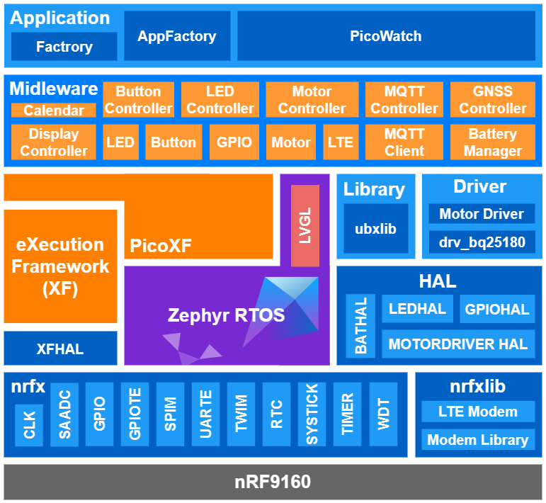
Software Part
LTEWatch Application Diagram
Peripherals Driver (Nordic): nrfx
Modem Driver (Nordic): nrfxlib
RTOS: Zephyr RTOS
RTOS
LVGL
Executive Framework: XF
XFHAL / XF / PicoXF
Hardware Abstract Layer : HAL
BATHAL
LEDHAL / GPIOHAL
MOTORDRIVER HAL
External Library (u-blox): ubxlib
Custom Driver : Driver
Motor Driver (HEVS)
drv_bq25180
Middleware
Calendar, LED, Button, GPIO, Motor, LTE, MQTT Client
Display Ctrl, Button Ctrl, LED Ctrl, Motor Ctrl, MQTT Ctrl, GNSS Ctrl, Battery Ctrl
Application
Factory, AppFactory
PicoWatch

Slide 31
Software Part
Software Architecture
…
….

Slide 32
Software Part
External Library
u-blox Host Library (ubxlib)
30+ built-in Widgets (Button, Label, Slider, Chart, Keyboard, Meter, Arc, Table)
Flexible Style system with (≈100 styles)
Flexbox & Grid-like layouts (size & position)
Texts are rendered with UTF-8 encoding
Word wrapping, kerning, text scrolling
Rendering engine supporting animations, anti-aliasing, opacity, smooth scrolling, shadows, image transformation
Supports Mouse, Touchpad, Keypad, Keyboard, External buttons
Multiple display support
Light and Versatile Graphics Library (LVGL)
A fully portable C (C++ compatible) library with no external dependencies
Can be compiled to any MCU or MPU, with any (RT)OS
Supports monochrome, ePaper, OLED or TFT displays
Needs only 32 kB RAM and 128 kB Flash, a frame buffer, and at least an 1/10 screen sized buffer for rendering

Slide 33
Software Part
Hardware Description
…
….

Slide 34
Test & Result
LTEWatch Device
BLOCK | SPECIFICATION | OK/KO
Power supply | Powered by a battery | OK
 | Rechargeable by USB-C and WPC | OK
 | Battery life of at least one day | OK
Data Display | Time is displayed with 3 clock hands | OK
 | LCD must be implemented | OK
User Interface | The user interface must be done with four push-buttons | OK
 | Accelerometer can be added | OK
Computing Unit | Must use the nRF9160 | OK
RF Comm. | Must implement a GNSS receiver | OK
 | Must implement an LTE-M/NB-IoT transceiver | OK
 | Must have on-board antenna for both GNSS and LTE-M | OK
 | Must have SMA connectors for GNSS and LTE-M | OK
Mechanical | Build a prototype board | OK
ThingsBoard Dashboard
GNSS position tracking on OpenStreetMap
Number of satellites (SVS)
Speed of the device in km/h
Battery level in %
Battery level in mV
Last published altitude of the device
Graphs of published altitude, speed, SVS and battery level values

Slide 35
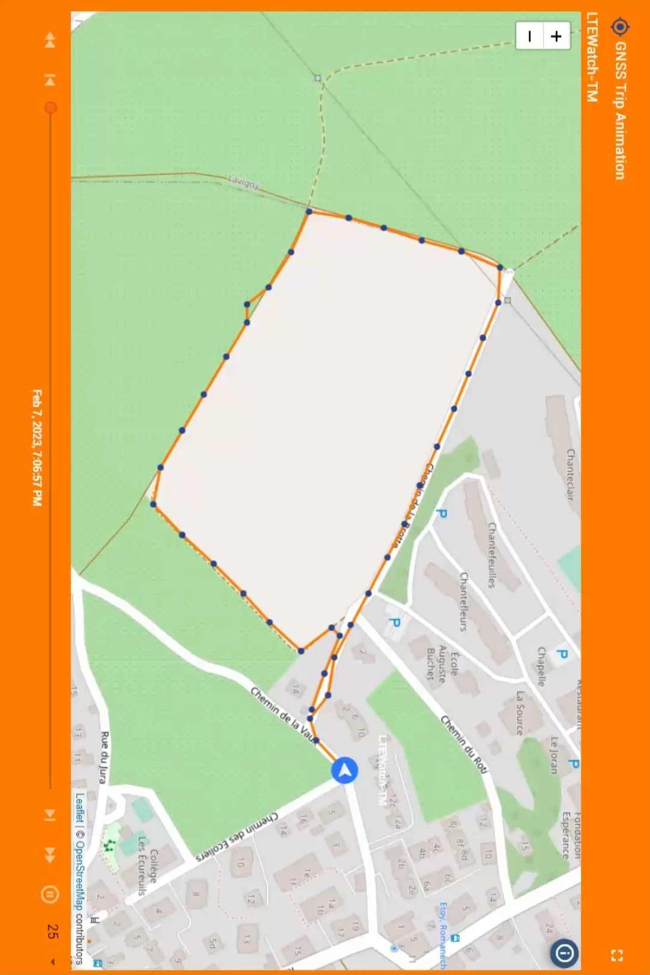

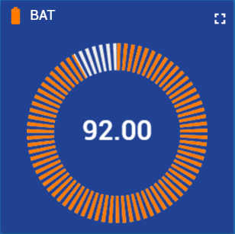
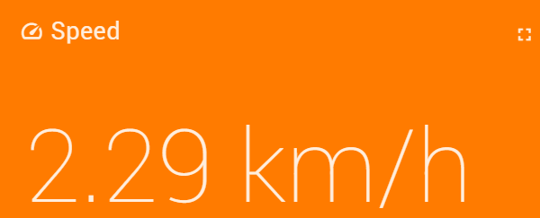
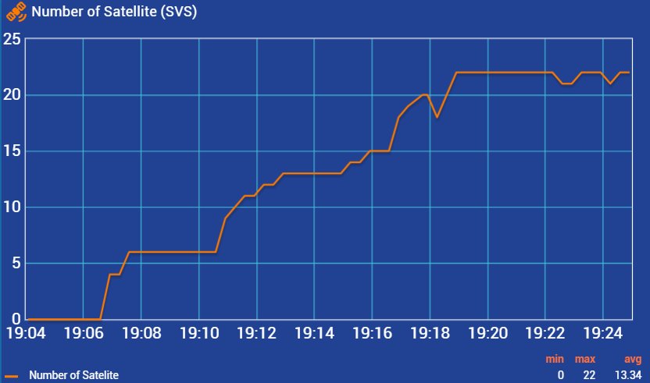
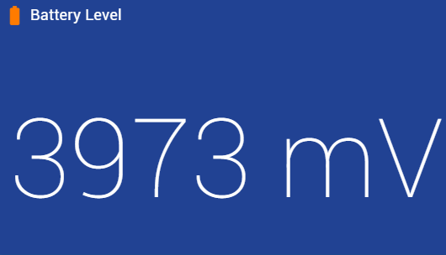
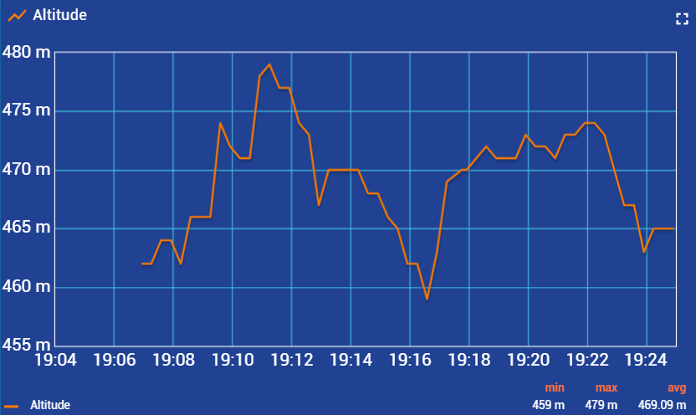
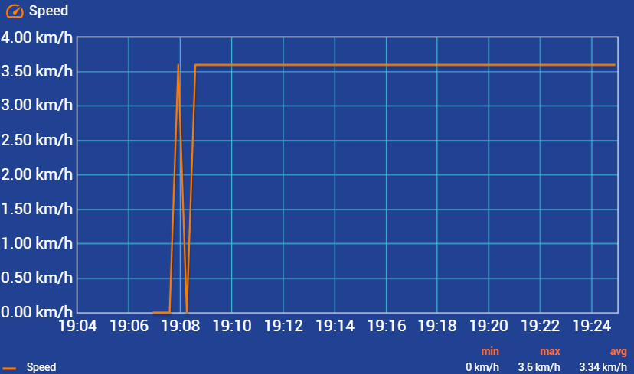
Test & Result
GNSS & LTE-M/NB-IoT

Slide 36
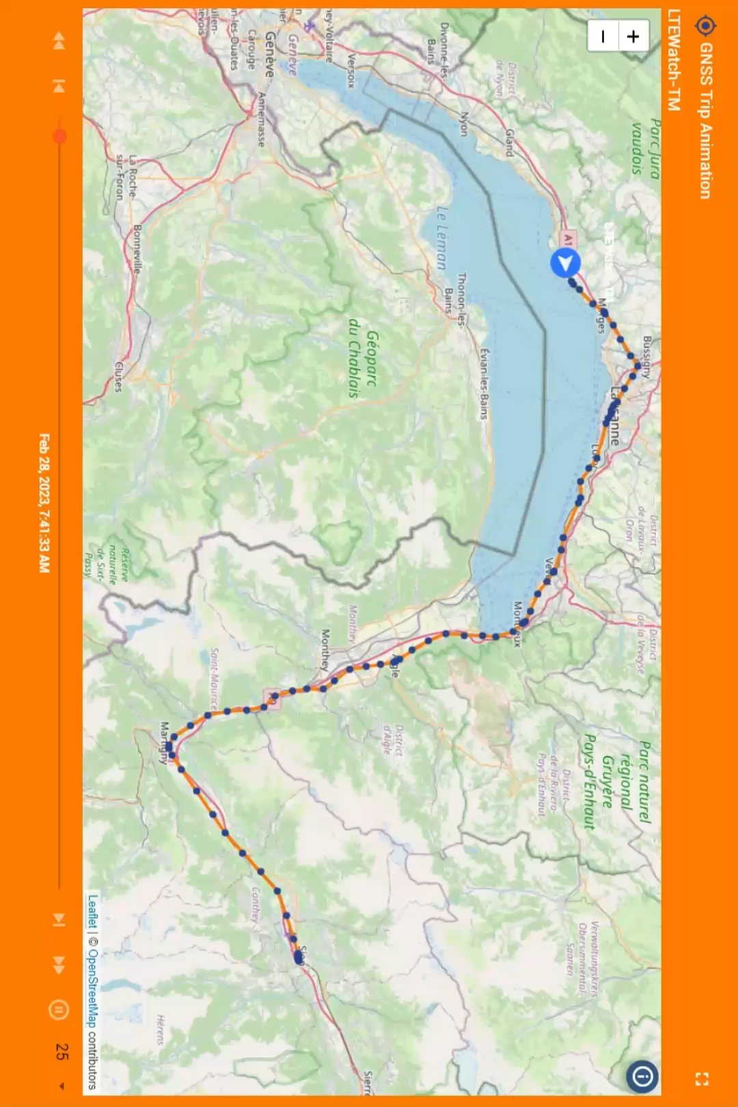
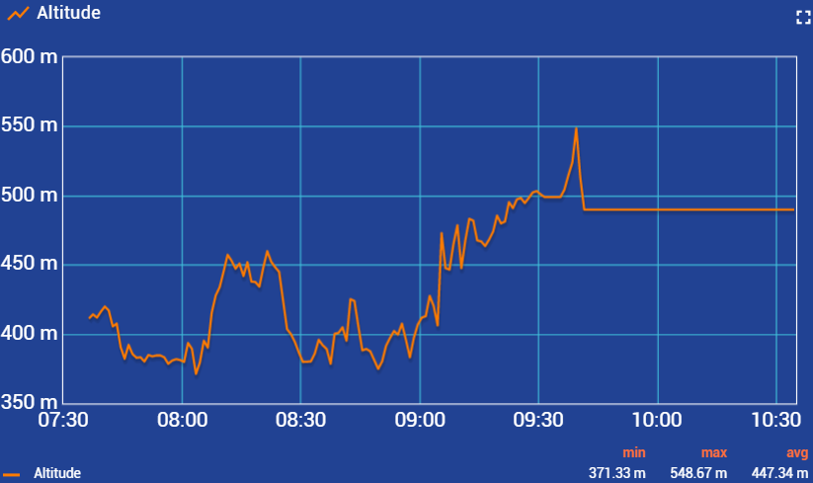
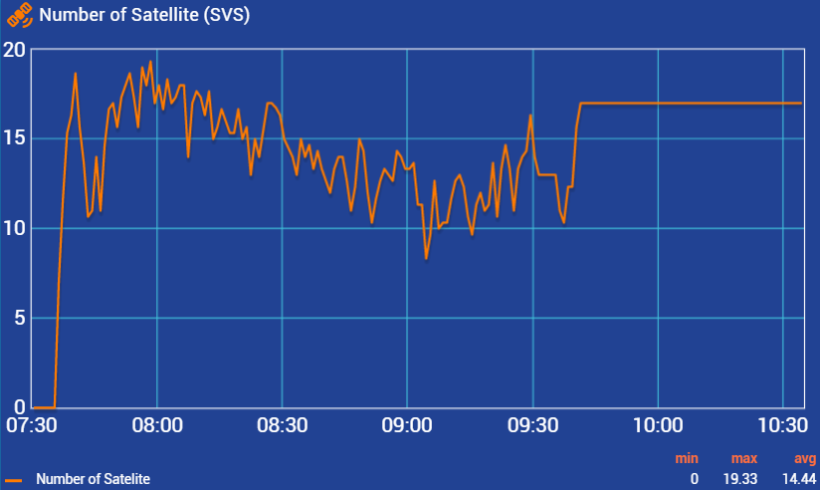
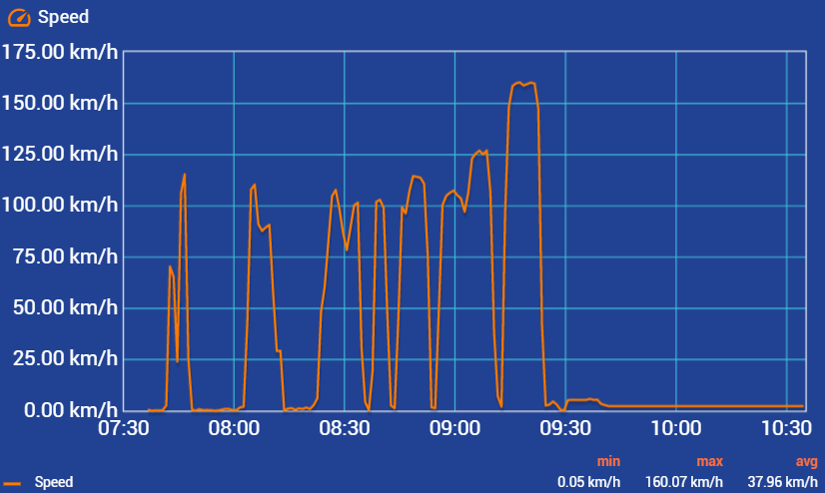
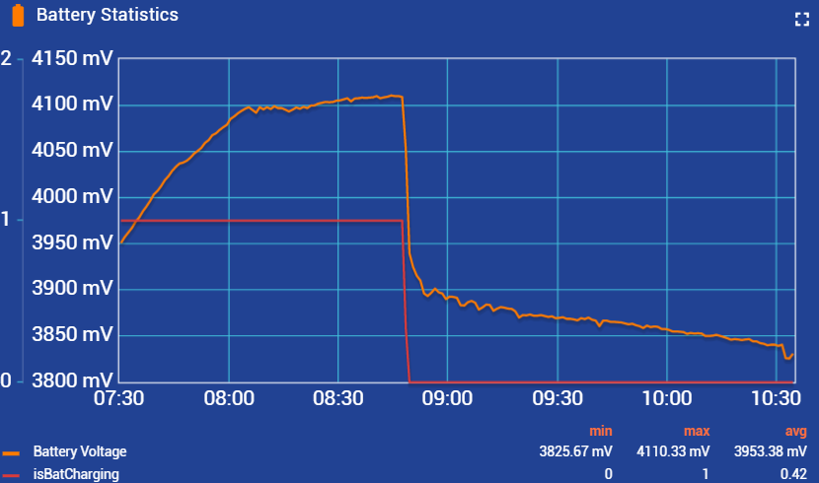
Test & Result
GNSS & LTE-M/NB-IoT

Slide 37
Discussion
Personal Evaluation
…
….

Slide 38
Discussion
Remaining Work
…
….

Slide 39
Conclusion
…
….

Slide 40

Questions

